Slide 1
ISM 6564
Text Analytics
Dr. Tim Smith

Slide 2
Agenda
Determining Text Similarity
Word Embedding (Word2Vec)
Document Embedding
Retrieval Augmented Generation (RAG)
Final Project (and Team Assignment)

Slide 3
Determining Text Similarity

Slide 4
Review – matrix representations of text corpus
Binary BOW
All words are equally important
It makes it difficult to differentiate between documents
Raw Frequency BOW
The highest-frequency words are not informative
You can remove stop words to address this, but high-frequency, unimportant words remain.
The solution to these problems…
Take the frequency across all documents and use relative frequency instead.

Slide 5

Term Frequency
$$tf\left(t, d\right)= f_{t,d}$$
Given a word (t) in document (d)
The term frequency is just the number of times this word t occurs in document (d)
tf(“house”, D1) = 10
tf(“house”, D2) = 1000
… This doesn’t mean the house is more meaningful in D2, as D2 could be a much larger document.

Slide 6

… we therefore ‘soften’ the effect of large frequencies…
$$tf\left(t,d\right)=\log_{10}(f\left(t,d\right)+1)$$
Doesn’t need to be base 10
We add one just in case f(t,d) turns out to be zero.
tf(“house”, D1) = log₁₀(10+1) = 1.041
tf(“house”, D2) = log₁₀(1000+1) = 3.000
Though the frequency of house is 100 times greater in D2 than D1, the updated tf results is less than 3x larger.

Slide 7
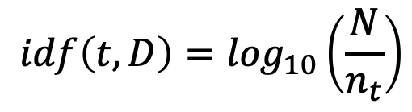
Inverse Document Frequency
Helps us regulate how important a term in a document is
$$idf\left(t,D\right)=\log_{10}\left(\frac{N}{n_{t}}\right)$$
N is the number of documents
n_{t} is the number of documents t appears in
Given term (t) and corpus (D)
The fewer documents that t appears in, the higher the IDF value will be, and the more weight it will give the word.

Slide 8

TD-IFD
$$w_{t,d}=tf\left(t, d\right) ∗idf(t, D)$$
The more frequent a term appears in a given document
The fewer times it appears in other documents
The higher it’s TF-IDF value

Slide 9
What can we do with these matrix representations of text?
As we saw last class, we can use these matrix representations of text as features.
These can be used as input to machine learning model training.
ML techniques such as:
K-nn,
Decision Trees
Random Forests
AdaBoost
XGBoost
SVC/SVM
Naïve Bayes
Neural Networks
Etc.
We also saw last week we can mix these matrices with other columnar data and use these other data as features to help improve our predictive modeling.

Slide 10
What other uses?
Similarity Search
Searching through data for similar items is a common operation in databases, search engines, and many other applications.
Finding similar items based on fixed numeric criteria is very straightforward using a query language:
SELECT * students WHERE grade > 95;
What happens when we have text?
We can use the techniques learned thus far!

Slide 11

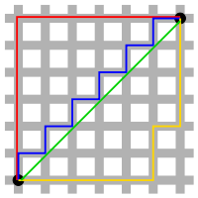

Measuring Similarity
y
Euclidian distance:
Shortest distance among two vectors (based on Pythagoras’ Theorem)
Manhattan distance:
Absolute difference of Cartesian coordinates.
Cosine similarity:
Cosine of the angular distance between two vectors:
x
d(x, y) =
cos(θ)
v_{i} is the count for word v in context i
w_{i} is the count for word w in context i

Slide 12
Cosine Similarity Example
Which pairs of words are most similar?
cosine(apricot,
information)
cosine(digital,
information)
cosine(apricot,
digital)
cos (0) = 1 → Vectors point in the same direction; words most similar
cos(180) = -1 → Vectors point in opposite directions; words opposite of each other
cos(90) = 0 → Vectors are perpendicular;
words are unrelated
 | large | data | computer
apricot | 1 | 0 | 0
digital | 0 | 1 | 2
information | 1 | 6 | 1
=
=
=
Visualizing cosines (angles)
=

Slide 13
Using distance measures to determine similarity
There are many other distance measures, but Cosine similarity is most frequently used for text.
This is partly because cosine similarity is less affected by differences in magnitude.
Follow along with the professor as he reviews example notebooks.

Slide 14
Embeddings

Slide 15
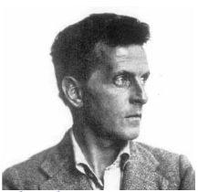
What is the problem with TF-IDF?
As we saw in the tutorial/notebook example, TF-IDF can be helpful in identifying documents based on syntax, but TF-IDF doesn’t encode information on meaning.
Human language is not just a collection of words. We make sense of language by interpreting words' meaning, relationships, and context, e.g., the utterance “Water!” could be an order, the answer to a question, or some other form of communication.
“The meaning of a word is in its use in the language”
Ludwig Wittgenstein
(Aphorism # 43, Philosophical Investigations, 1953)

Slide 16
Polysemy
What is polysemy?
Multiple meanings of the same word (in different contexts).
Each meaning is called a “sense” (or concept).
Identifying a word's “sense” (meaning) is called Word Sense Disambiguation.
Examples:
Bank (financial institution or side of the river?):
He went to the bank to withdraw money.
She is down by the river bank.
Battery (an object or an act):
My cell phone battery just died.
He was arrested for assault and battery (and act).
Get (procure or understand):
She gets it.
Can you get me some water?

Slide 17
What we want
We want to translate a corpus into a matrix representation that embeds the words' meaning in a sentence.
Syntactic Similarity
The combination of Lemmatization and TD-IDF can determine this
Semantic Similarity & Semantic Relatedness
TF-IDF?
TD-IDF cannot encode this information – we need something that can.
Symantec Similarity
Feline
cat
Syntactic Similarity
Symantec Relatedness
run
running
car
truck
road

Slide 18
Zero cosine similarity using the bag of words techniques we’ve used so far.
“Feline climbs tree”
“Cat scrambles up oak”
But, if we used a technique called “word embedding” vectors, we would get a similar score.

Slide 19
The cat scratched the chair.
The cat purred as it was petted.
A cat meows.
The cat chased a mouse.
The sinkataddle scratched the chair.
The sinkataddle purred as it was petted.
The sinkataddle meows.
The sinkataddle chased a mouse.
Distributional Hypothesis:
Words that occur in similar contexts have similar meanings.
We can represent context by looking at surrounding words.
We are confident that a sinkataddle is a type of house cat because of the context we find the word used if very similar to the context in which a house cat is use.
What’s a sinkataddle?

Slide 20
Word2Vec
Many algorithms are available to help us capture the meaning of a word or sentence.
One of the first successful methods was called Word2Vec.
In 2010, with co-authors, Tomáš Mikolov (then at Brno University of Technology) applied a simple recurrent neural network with a single hidden layer to language modeling.
Word2vec was created, patented, and published in 2013 by a team of researchers led by Mikolov at Google over two papers.
https://arxiv.org/abs/1301.3781
https://arxiv.org/abs/1310.4546

Slide 21
House =
[ 1.57226562e-01 -7.08007812e-02 5.39550781e-02 -1.89208984e-02 9.17968750e-02 2.55126953e-02 7.37304688e-02 -5.68847656e-02 1.79687500e-01 9.27734375e-02 9.03320312e-02 -4.12109375e-01 -8.30078125e-02 -1.45507812e-01 -2.37304688e-01 -3.68652344e-02 8.74023438e-02 -2.77099609e-02 1.13677979e-03 8.30078125e-02 3.57421875e-01 -2.61718750e-01 7.47070312e-02 -8.10546875e-02 -2.35595703e-02 -1.61132812e-01 -4.78515625e-02 1.85546875e-01 -3.97949219e-02 -1.58203125e-01 -4.37011719e-02 -1.11328125e-01 -1.05957031e-01 9.86328125e-02 -8.34960938e-02 -1.27929688e-01 -1.39648438e-01 -1.86523438e-01 -5.71289062e-02 -1.17675781e-01 -1.32812500e-01 1.55639648e-02 1.34765625e-01 8.39843750e-02 -9.03320312e-02 -4.12597656e-02 -2.51953125e-01 -2.27539062e-01 -6.64062500e-02 -7.66601562e-02 5.15136719e-02 5.90820312e-02 3.49609375e-01 -1.13769531e-01 -2.57568359e-02 -1.98242188e-01 4.44335938e-02 1.09863281e-01 1.04003906e-01 -1.75781250e-01 1.22558594e-01 7.81250000e-02 6.20117188e-02 6.49414062e-02 -1.73828125e-01 -1.11694336e-02 1.88476562e-01 3.34472656e-02 -4.29687500e-02 -4.71191406e-02 2.91015625e-01 4.19921875e-02 1.59179688e-01 1.22558594e-01 -2.55859375e-01 2.44140625e-01 1.54296875e-01 -3.46679688e-02 1.24023438e-01 -1.32812500e-01 8.44726562e-02 3.71093750e-02 -1.05468750e-01 9.81445312e-02 -8.23974609e-03 5.34667969e-02 -1.96838379e-03 9.03320312e-02 1.30859375e-01 -1.57470703e-02 -2.40478516e-02 -3.29589844e-02 -5.63964844e-02 -3.12500000e-01 -1.19140625e-01 4.41894531e-02 -1.82617188e-01 -2.20703125e-01 8.39843750e-02 -2.15820312e-01 -1.60156250e-01 -2.01171875e-01 1.63085938e-01 -4.57763672e-05 4.24804688e-02 -1.37695312e-01 -2.62451172e-02 1.53320312e-01 -1.07421875e-01 -1.34765625e-01 -3.73840332e-03 -1.51977539e-02 -7.27539062e-02 3.22265625e-02 1.89453125e-01 -8.00781250e-02 1.45507812e-01 -9.66796875e-02 -9.27734375e-02 8.91113281e-03 -4.27246094e-02 -9.76562500e-02 3.29589844e-02 -7.95898438e-02 -6.25000000e-02 3.39355469e-02 1.05590820e-02 -1.28906250e-01 1.09863281e-01 1.89453125e-01 1.52343750e-01 -1.47460938e-01 -3.86047363e-03 1.75781250e-01 -4.58984375e-02 -1.02539062e-01 6.34765625e-02 -9.86328125e-02 1.87500000e-01 3.97949219e-02 -2.65625000e-01 -1.24023438e-01 -1.35742188e-01 7.93457031e-03 6.59179688e-02 8.11767578e-03 -3.24707031e-02 -1.03759766e-02 -1.90429688e-02 -8.20312500e-02 2.06054688e-01 1.40625000e-01 1.93359375e-01 2.91015625e-01 -9.17968750e-02 -1.40625000e-01 -1.75781250e-01 -1.36718750e-01 2.51464844e-02 -5.83496094e-02 -1.84570312e-01 3.10546875e-01 7.17773438e-02 -1.01074219e-01 1.08886719e-01 -2.23388672e-02 1.50390625e-01 -7.03125000e-02 1.24023438e-01 2.21679688e-01 -1.97265625e-01 -6.05468750e-02 -4.30297852e-03 -1.69921875e-01 -1.45507812e-01 -2.17773438e-01 2.47070312e-01 6.64062500e-02 -8.05664062e-02 3.57421875e-01 -8.20312500e-02 -7.87353516e-03 1.08886719e-01 -5.32226562e-02 3.00781250e-01 -2.37304688e-01 1.61132812e-01 1.59179688e-01 1.69921875e-01 -9.52148438e-02 5.20019531e-02 -6.22558594e-02 -8.85009766e-03 4.68750000e-02 -2.88085938e-02 1.25000000e-01 3.49121094e-02 4.61425781e-02 1.66015625e-02 -9.57031250e-02 -1.48437500e-01 -1.64794922e-02 -2.22656250e-01 -2.51953125e-01 -3.58886719e-02 -2.52685547e-02 8.39233398e-05 6.98242188e-02 2.53906250e-01 -3.29589844e-02 6.59179688e-02 6.28662109e-03 -7.86132812e-02 -3.01513672e-02 -9.47265625e-02 1.25000000e-01 -1.62109375e-01 2.53906250e-01 -3.30078125e-01 6.44531250e-02 -9.09423828e-03 7.12890625e-02 3.99780273e-03 -4.41894531e-02 -1.42822266e-02 -9.52148438e-03 1.17675781e-01 3.49609375e-01 -2.90527344e-02 1.86767578e-02 3.46679688e-02 1.89208984e-02 -1.26953125e-01 2.68554688e-02 -1.06933594e-01 1.20117188e-01 -2.69775391e-02 -5.07812500e-02 -1.76757812e-01 3.95507812e-02 1.35742188e-01 -9.61914062e-02 -1.98242188e-01 -1.86767578e-02 -2.47802734e-02 -5.32226562e-02 1.54296875e-01 5.95703125e-02 6.39648438e-02 -6.17675781e-02 3.36914062e-02 1.75781250e-01 6.59179688e-02 2.22656250e-01 -1.28906250e-01 4.61425781e-02 -2.57812500e-01 6.78710938e-02 6.29882812e-02 -1.15722656e-01 -2.13867188e-01 -2.53906250e-01 2.73437500e-02 -4.68750000e-02 1.38671875e-01 2.59765625e-01 -2.07031250e-01 -9.64355469e-03 -5.22460938e-02 -7.20214844e-03 8.49609375e-02 -2.49023438e-02 1.94335938e-01 -7.37304688e-02 1.22070312e-01 -3.49121094e-02 1.41601562e-01 -1.38671875e-01 7.61718750e-02 -1.93359375e-01 1.64062500e-01 -2.78320312e-02 -1.45263672e-02 1.44531250e-01 1.75781250e-01 -1.70898438e-02 1.26953125e-01 3.39355469e-02 -2.80761719e-02 1.82617188e-01 -2.94921875e-01 3.78417969e-02 -1.63085938e-01 1.73828125e-01 -1.01074219e-01 -1.49414062e-01 -4.17480469e-02 9.82666016e-03 -4.94384766e-03 -3.29589844e-02]
300 feature representation of the house
Notice that this is a ‘dense vector’
It’s also much smaller than a total vocabulary would have

Slide 22
Interpreting a Vector
Like neural networks, we don’t have an interpretation of what the vectors are…
House = [1.57226562e-01, -7.08007812e-02, 5.39550781e-02 ... 9.82666016e-03, -4.94384766e-03, -3.29589844e-02]
Dwellingness?
Sizeness?
Shapeness?
…
Despite not knowing what these dimensions are representing, as long as related words (either syntactically, or semantically) are close together in n-dimensional space – these vectors will prove quite useful.

Slide 23
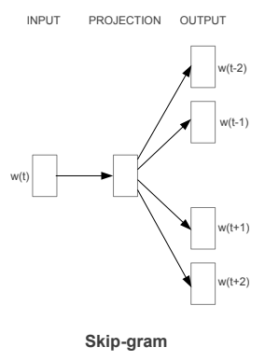
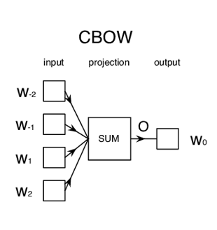
Word2Vec Algorithm
Two algorithm options…
Given a set of words with one word missing, the algorithm has to guess the word.
Given a word, the algorithm must predict the surrounding words.
The skip-gram algorithm is the most common, and usually the most accurate.

Slide 24
Skip-Gram with Negative Sampling (SGNS)
Goal, create vectors which:
Maximize similarity (dot product) between words that appear in similar contexts.
Minimize similarity between words that do not appear in similar contexts.
Garage
house
Garage
house
guitar
guitar
https://ronxin.github.io/wevi/

Slide 25
Skip-gram Negative Sampling
i-2
i-1
i
i+1
i+2
I have two tickets to the Tampa Bay Lighting game for this Friday.
Input word
Output Context words

Slide 26
Skip-gram Negative Sampling
Sliding window of size 5
i-2
i-1
i
i+1
i+2
I have two tickets to the Tampa Bay Lighting game for this Friday.
Input word
Output Context words

Slide 27
Skip-gram Negative Sampling
Sliding window of size 5
i-2
i-1
i
i+1
I have two tickets to the Tampa Bay Lighting game for this Friday.
Input word
Output Context words

Slide 28
Skip-gram Negative Sampling
i-2
i-1
i
i+1
i+2
I have two tickets to the Tampa Bay Lighting game for this Friday.
Input/Target word
NEGATIVE EXAMPLES:
Context/Target Pairs:
(???, Lightning)
(???, Lightning)
(???, Lightning)
(???, Lightning)
POSITIVE EXAMPLES:
Context/Target Pairs:
(Bay, Lightning)
(Tampa, Lightning)
(Game, Lightning)
(For, Lightning)
Output Context words
Sample Random Word from Vocabulary
Self Supervised Learning
Training Set

Slide 29
Using Word2Vec
Train your own Model
Use a pre-trained model
Fine-tune an existing model so that it recognizes new words
Follow along with the professor as he demonstrates this in a notebook.

Slide 30
When Words Fail: Semantics
Examples:
The following sentences have the exact same words but mean different things:
“John and David studied Math and Science.”
“John studied Math and David studied Science.”
The following sentences have very different words but convey the same meaning:
“Mary is allergic to dairy.”
“Mary is lactose-intolerant.”
Sentences provide context and meaning, not individual words.
Doc2Vec, Paragraph2Vec.
Deep learning based sentence transformers.

Slide 31
Extension of Word2Vec
Doc2Vec or Paragraph2Vec:
Proposes a paragraph vector: an unsupervised algorithm that learns fixed-length feature representations from variable length documents.
This representation attempts to inherit the semantic properties of words such that “red” and “colorful” are more similar to each other than they are to “river” or “governance.”
Ordering of words are also considered within a narrow context, similar to an n-gram model.
Advantages:
Results are more effective than a bag-of-words or bag-of-n-grams model because they:
Capture context.
Have lower dimensionality (and of fixed length) than BOW; hence better suited for ML algorithms.
Implementation:
Word2Vec and Doc2Vec are both implemented using Gensim.

Slide 32
Retrieval Augmented Generation

Slide 34
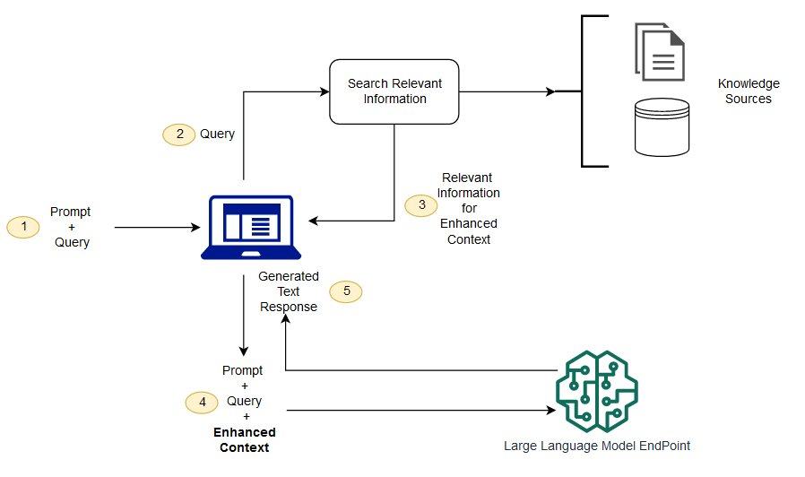
https://docs.aws.amazon.com/sagemaker/latest/dg/jumpstart-foundation-models-customize-rag.html

Slide 35
The retrieval of relevant information is typically implemented by vectorizing knowledge source text using word embedding.
Given a query, this query is then transposed to a vector using the same word embedding algorithm used for the knowledge source text.
Finding relevant text then becomes a ‘similarity’ search in n-dimensional space – using a metric such a cosine similarity to identify portions of the knowledge text that are most relevant.
https://docs.aws.amazon.com/sagemaker/latest/dg/jumpstart-foundation-models-customize-rag.html

Slide 36
With relevant text identified from the knowledge base, this text is then summarized.
This summarized text is then used to augment a user's query with important contextual information.
With this contextual information, the LLM can ‘learn’ things it didn’t know before and respond with higher-quality answers.
https://docs.aws.amazon.com/sagemaker/latest/dg/jumpstart-foundation-models-customize-rag.html

Slide 37
The key algorithms used
Vectorized text using embedding algorithms
Text summarization using LLM
Answer augmented queries using LLM

Slide 38
Libraries that can be used
LangChain
LlamaIndex
Others are emerging
These libraries integrate RAG functionality to make it much easier to develop ChatBot (and related) systems.
LangChain is the most mature; and the one we will be used for the final project.

Slide 39
This week
The first step for your project is identifying the business process details and identifying data that can be used for your knowledge base. You need to set up a meeting with Dr. Reichgelt ASAP. You have a report to complete and submit by Sunday at midnight.
Next week:
I will provide more background on embedding and review the latest approaches.
Demonstrate LangChain
Discuss ‘prompt engineering’.

Slide 40
Happy Learning!

